Slide 1
Word embedding & LM pre-training
Reporter: Li Qingtao

Slide 2
Outline
Feature-based method: word2vec, context2vec, ELMo
Fine-tuning method: GPT, ULMFiT
Newest work: BERT

Slide 3
Outline
Feature-based method: word2vec, context2vec, ELMo
Fine-tuning method: GPT , ULMFiT
Newest work: BERT

Slide 4
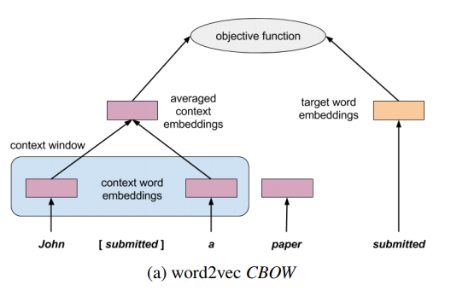
word2vec
Efficient Estimation of Word Representations in Vector Space, ICLR 2013

Slide 5
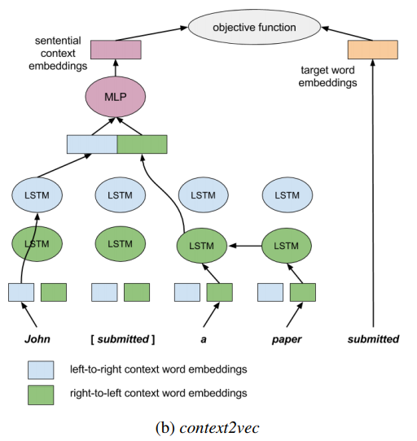
context2vec
context2vec: Learning Generic Context Embedding with Bidirectional LSTM, CONLL 2016

Slide 6
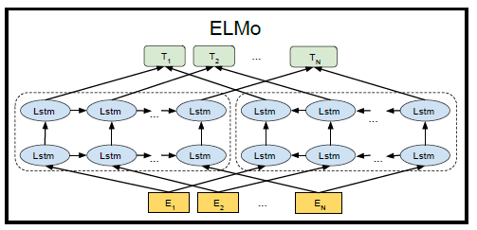
ELMo
softmax
biLSTM
Token embedding : a CNN over characters
Deep contextualized word representations, NAACL 2018 best paper

Slide 7
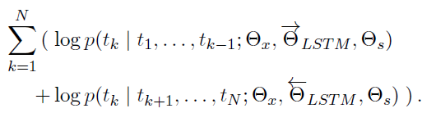
ELMo
objective function: language model
Deep contextualized word representations, NAACL 2018 best paper

Slide 8




ELMo
Token representation:
scale factor
for specific tasks
softmax-normalized weight over layers
:ELMo enhanced representation
→ specific task models
Deep contextualized word representations, NAACL 2018 best paper

Slide 9
Why called “feature-based”?
Embeddings of different granularities are used as features in a downstream model.
Word embedding, sentence embedding, paragraph embedding…
Context-sensitive word embedding…

Slide 10
Outline
Feature-based method: word2vec, context2vec, ELMo
Fine-tuning method: GPT , ULMFiT
Newest work: BERT

Slide 11
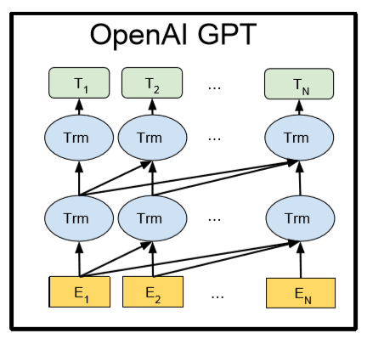
GPT
softmax
Transformer blocks（with some changes)
Token embedding
+
position embedding
Improving Language Understanding by Generative Pre-Training, OpenAI preprint

Slide 12

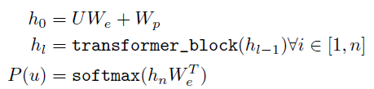



GPT
objective function: language model
Pre-train
Fine-tune
实验发现，这一项的影响不明显
Improving Language Understanding by Generative Pre-Training, OpenAI preprint
Notes:
U: token sequence
C: dataset

Slide 13
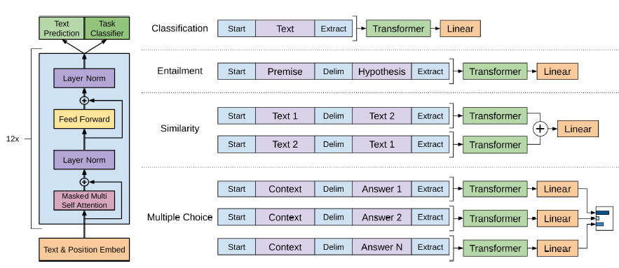
GPT
Improving Language Understanding by Generative Pre-Training, OpenAI preprint

Slide 14
ULMFiT (just mention it)
Steps:
a) General-domain LM pre-training
b) target task LM fine-tuning
c) target task classifier fine-tuning
Universal Language Model Fine-tuning for Text Classification, ACL 2018

Slide 15
Outline
Feature-based method: word2vec, context2vec, ELMo
Fine-tuning method: GPT , ULMFiT
Newest work: BERT

Slide 16
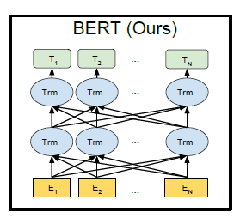
BERT
softmax
Transformer blocks
(origin)
Token embedding
+
position embedding
+
segment embedding
Pre-training of Deep Bidirectional Transformers for Language Understanding, Google

Slide 17
BERT
objective function: NOT language model
BUT another two tasks
Masked LM: predict masked words
Next Sentence Classification: yes/no
Pre-training: 128,000 tokens/batch, 1,000,000 steps,
which took 4 days on 64 TPUs…
来自大厂的任性
Fine-tuning: took 3-4 epochs to convergences
Pre-training of Deep Bidirectional Transformers for Language Understanding, Google
Notes:
Masked LM: 作用与上述方法类似
Next Sentence Classification: 为了理解句子间的关系，在一些NLP任务中有用

Slide 18
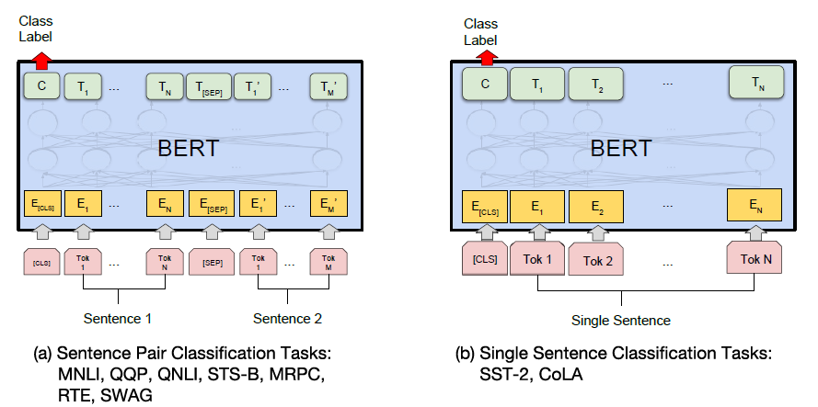
BERT
Fine-tuning procedure:
Pre-training of Deep Bidirectional Transformers for Language Understanding, Google

Slide 19
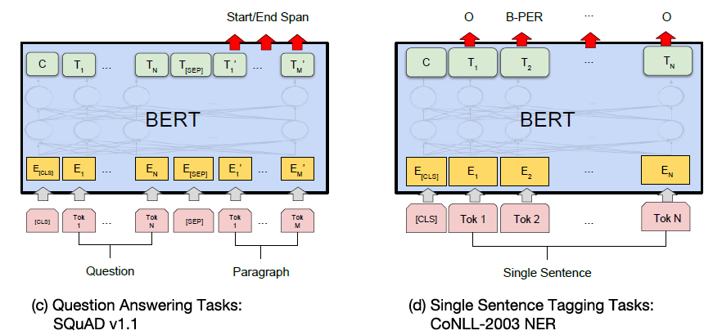
BERT
Fine-tuning procedure:
Pre-training of Deep Bidirectional Transformers for Language Understanding, Google

Slide 20
BERT
Comparison with GPT:
CORE: pre-training task
Pre-training corpus: 800M vs 3300M
Pre-training batch size: 32000 vs 128000 tokens
Training tricks: learning rate, etc.
Pre-training of Deep Bidirectional Transformers for Language Understanding, Google

Slide 21
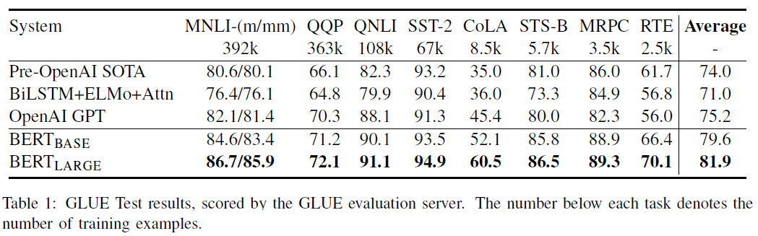
BERT
Pre-training of Deep Bidirectional Transformers for Language Understanding, Google

Slide 22
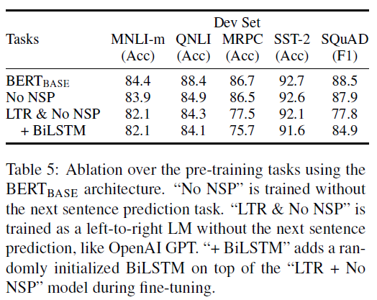
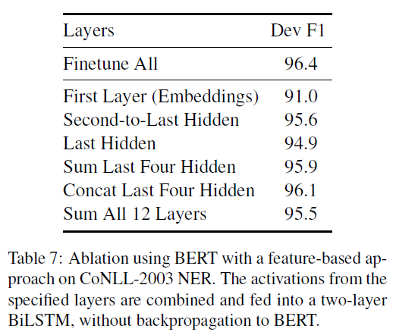
BERT
Pre-training of Deep Bidirectional Transformers for Language Understanding, Google

Slide 23
Summary
目前效果最好的GPT和BERT都使用基于attention的transformer结构，代替原先的LSTM
以语言模型为基础，进行大规模无监督预训练
预训练任务的通用性和典型性？
在预训练中，融合了word embedding和更高层级表示的训练过程（GPT vs ELMo），更优雅地解决了静态word embedding与具体语境的交互问题
似乎没有看到生成方面的实验…
以上观点欢迎讨论

Slide 24
Thanks for Listening!
Any Questions?

